Slide 1






CONTACT
MANAGER
Presented by: Team Synergy

Slide 2



Introduction
General concepts
we're presenting our Contact Manager project, crafted with PHP, HTML, CSS, JavaScript, and SQL. Managing contacts seamlessly is crucial in our connected world. Our solution offers dynamic interface design, robust backend database management, and streamlined user experience. Let's explore how it revolutionizes contact management.

Slide 3






Project Objectives
Adding contacts
contacts entered are distinguished between each other by having a unique constraint for both names and mobile numbers
Entering duplicate names are not permitted.
Data Base
The data management is done My SQL.
Contact table consists of name , mobile number, email, gender, locality, unique id
Delete and Search
Delete contacts in hassle free manner.
Search contacts with mobile number or name

Slide 4




Features
ADD CONTACT
DELETE CONTACT
SEARCH CONTACT
We can add contact by entering the following details:
Name
Mobile Number
E mail
Gender
Locality
We Have ‘ X ‘ icon the card containing contact details
when Pressed the the contact id associated with it will be used to delete whole contact details of specific person
We can search contacts in the contact manager using either name or mobile number

Slide 5
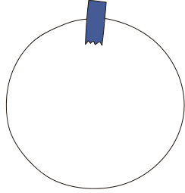










WORKING
SAVE CONTACT
SUCCESS.PHP
CONTACTS.SQL
Contact.HTM
ADD CONTACT
HOME.PHP
DELETE CONTACT
DELETE-CONTACT.PHP
CONTACT DETAILS
CARD.PHP
SEARCH CONTACT
SEARCH-CONTACT.PHP

Slide 6


TEAM
SANTHAN
SURYA
PUNEETH
KARTHIKEYA
ANJUM
DHANUSH

Slide 7

Thank's For Watching

